Slide 1



CHANDUBHAI S PATEL INSTITUTE OF TECHNOLOGY
DEPARTMENT OF COMPUTER SCIENCE AND ENGINEERING
CSE401- PROJECT MINOR
Project Title: Customer Preference and Trend Analytics for Retail Sector
(July 2026 to November 2026)
Prepared By
External Guide(s)
Internal Guide(s)
Pranav Patel(22cs060)
Mr. Divyang Shah
CEO and Founder
Electrosoft
Prof. Akshita Kadam
Assistant Professor
CSPIT-CSE

Slide 2





BUSINESS DEVELOPMENT GOALS OF THE PROJECT
Main Objective:
To analyze customer preferences and transaction trends to help the retail business make informed, data-driven decisions for improved profitability and customer retention.
Specific Goals:
Understand customer behavior patterns through transaction and demographic data.
Identify key factors influencing purchasing decisions — such as income, age, product type, and customer segment.
Track product performance and sales trends across different regions and time periods.
Optimize marketing and sales strategies based on customer segmentation insights.
Improve operational efficiency by analyzing payment, shipping, and feedback data.
Reduce decision uncertainty by converting large datasets into actionable insights via Power BI dashboards.

Slide 3






PROJECT WORKFLOW OVERVIEW: FROM DATA TO INSIGHTS
2.Data Cleaning & Preprocessing (Python)
3.Exploratory Data Analysis (EDA) in Python
1. Data Collection
5. Insight Extraction via SQL
Collected 3,00,000 transaction and customer records
Customer Segmentation
Sales and product trends
Time-based insights
Top products, cities
Revenue by region
Repeat customer logic
Data validation
Handle nulls
Handle duplicates
Format date & time
Feature Engineering
7. Report & Business Insights
6. Dashboard Creation in Power BI
Sales overview
Customer behavior
Operational KPIs
Recommendations
Visual summaries

Slide 4

DATASET DESCRIPTION
Dataset Source: Kaggle – Retail Transactional Dataset (https://www.kaggle.com/datasets/bhavikjikadara/retail-transactional-dataset)
Initial Records: ~3,00,000 transaction and customer records
Total Columns: 28 attributes
Data Type: Transactional, Demographic, and Feedback data
Key Features: Customer_ID, Age, Gender, Product_Category, Payment_Method, Total_Amount, Ratings, Feedback, Date, Time, etc.
Purpose: To analyze customer purchasing patterns, product performance, and operational efficiency.

Slide 5




TOOLS & TECHNOLOGIES USED
Python (Jupyter Notebook): Used for data cleaning, preprocessing, and EDA.
SQLite3: Used for storing, querying, and extracting structured insights from cleaned data.
Power BI: Used for creating interactive dashboards and visual storytelling.
Power Query: Used for data transformation and integration before visualization.
DAX (Data Analysis Expressions): Used for creating KPIs, calculated columns, and measures in Power BI.
Excel: Used for quick data checks, exports, and intermediate reviews.

Slide 6
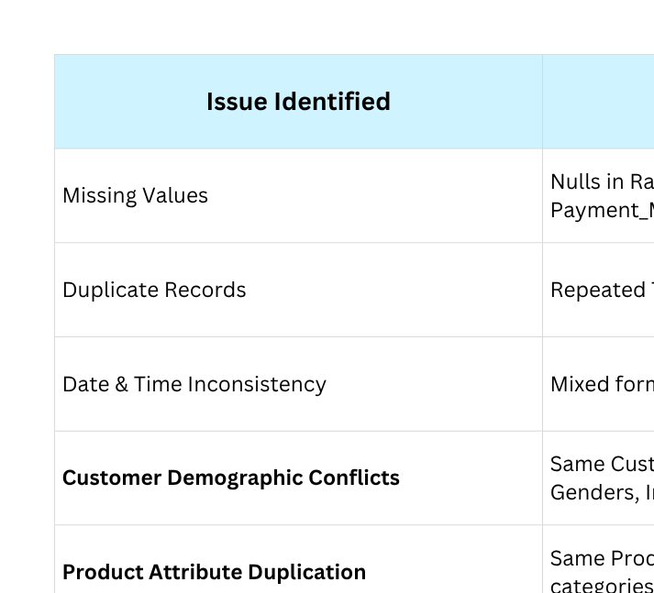
DATA CHALLENGES & INCONSISTENCIES

Slide 7
PHASE 1: DATA CLEANING
1. Removed Duplicates:
→ Eliminated redundant Transaction_ID records using the drop_duplicates() function.
2. Handled Missing Values:
→ Filled missing numeric fields (like Age and Ratings) with median values.
→ Categorical fields (Gender, Income, Customer_Segment) filled using mode or labeled as “Unknown.”
3. Standardized Date & Time Formats:
Converted all mixed date formats to YYYY-MM-DD.
→ Extracted new columns such as Year, Month, Hour, and Time_Slot (Morning, Afternoon, Evening, Night).
4. Feature Engineering:
→ Created analytical columns like Total_Purchases, Time_Slot, and Customer_Segment.
→ Added derived fields to support time-based and behavioral insights.
5. Data Reduction:
→ Retained only valid and complete transaction records.
→ Removed rows with missing or logically inconsistent values.
Final Outputs:
df_full_cleaned.csv → Cleaned & complete dataset (≈ 2.93 lakh rows)
df_time_cleaned.csv → Time-based dataset (≈ 1.77 lakh rows)

Slide 8

PHASE 2: EXPLORATORY DATA ANALYSIS (EDA)
Key Analyses & Charts (14 Total):
Top 10 Cities by Transactions
Top Product Categories by Transactions
Top Brands by Purchase Amount
Monthly Sales Trend
Country-wise Purchases
Income vs Total Amount Spent
Gender-based Spending
Customer Segment vs Average Spend
Shipping Method Performance
Payment Method Preference
Ratings vs Feedback
Time-of-Day Analysis
Repeat vs One-time Customers
Ratings vs Amount Spent
Objective:
To explore customer, product, and transaction patterns and uncover initial business insights.

Slide 9
PHASE 3: SQL INTEGRATION & DATA MODELING
Objective:
To structure the cleaned data into a relational model using SQLite3 and connect it with Power BI for efficient querying, relationships, and KPI generation.
Key Steps Performed:
Imported cleaned datasets (df_full_cleaned.csv, df_time_cleaned.csv) into SQLite3 using Python.
Designed a Star Schema for analytical efficiency and simplified reporting.
Created and validated Fact and Dimension tables.
Verified key relationships using SQL join queries.

Slide 10
PHASE 3: SQL INTEGRATION & DATA MODELING
Star Schema Design:
Fact_Transaction → Contains transaction metrics (Amount, Total_Purchases, Date_Key, Customer_ID, Product_Key).
Dim_Customer → Stores demographics (Customer_ID, Gender, Age_Group, Income, Segment).
Dim_Product → Contains product details (Product_Key, Product_Brand, Product_Category).
Dim_Date → Derived from Date column (Date_Key, Year, Month, Day).
Key Relationships:
Dim_Customer (1:M) → Fact_Transaction
Dim_Product (1:M) → Fact_Transaction
Dim_Date (1:M) → Fact_Transaction
Validation:
Executed SQL queries in Python to verify aggregation accuracy (e.g., total sales, customer counts, average spend).

Slide 11
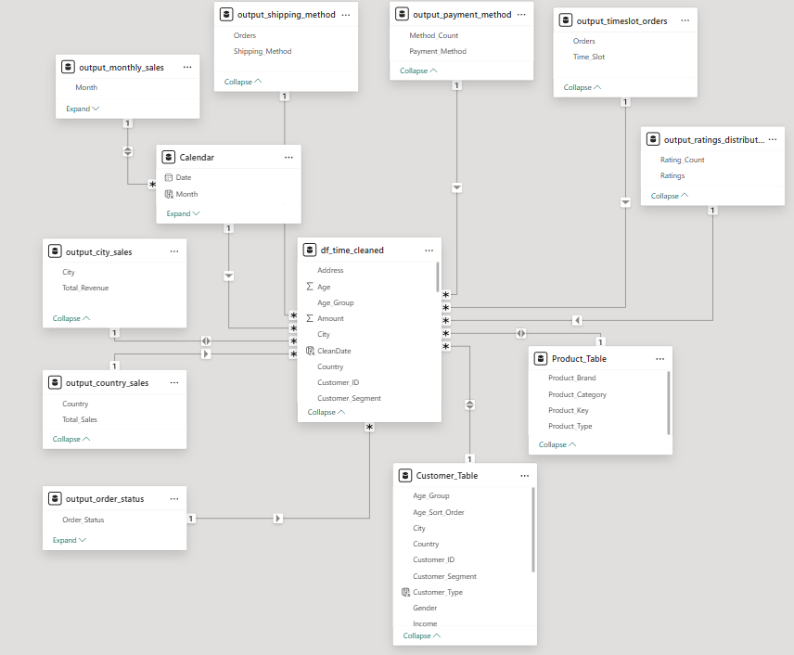
PHASE 3: SQL INTEGRATION & DATA MODELING

Slide 12
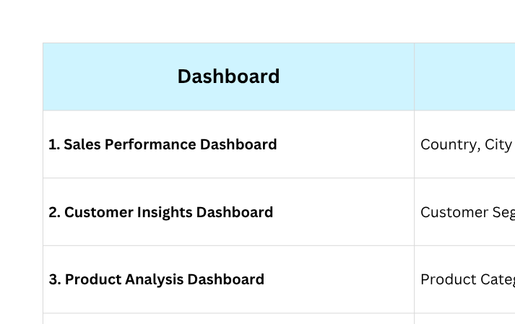
PHASE 4: POWER BI VISUALIZATION OVERVIEW
Objective:
To transform analyzed data into interactive and business-ready dashboards for strategic insights, performance monitoring, and decision-making.
Outcome:
All four dashboards together deliver a 360° Retail Business Intelligence Solution, connecting sales, customers, products, and operations into one unified analytical system.

Slide 13
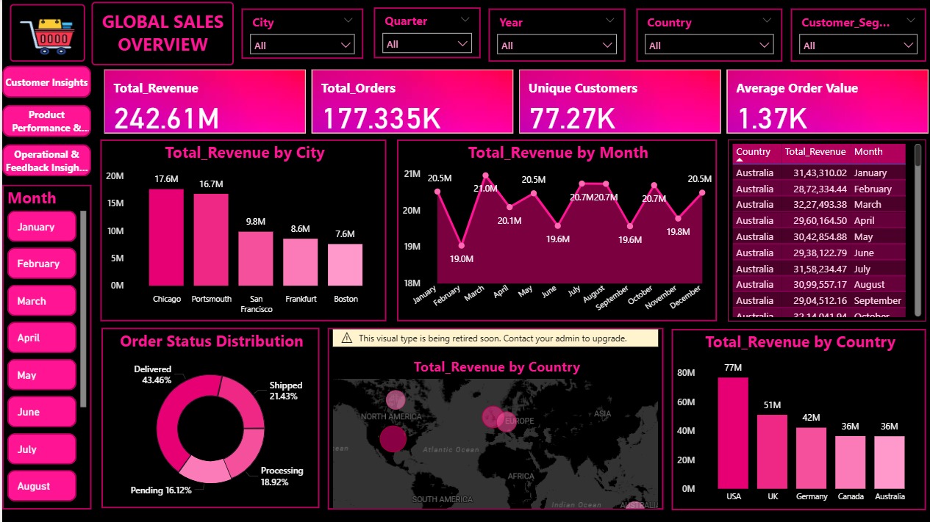
DASHBOARD-1: OVERVIEW

Slide 14
DASHBOARD-1: OVERVIEW
Purpose:
To provide a consolidated, high-level snapshot of overall sales performance, revenue distribution, and customer activity across all operating regions.
Dashboard Components:
KPI Cards: Total Revenue, Total Orders, Unique Customers, Average Order Value (AOV)
Bar Chart: Total Revenue by Country
Column Chart: Total Revenue by City
Line Chart: Month-wise Revenue Trend
Donut Chart: Order Status Distribution (Delivered, Pending, Returned, etc.)
Slicers: Country and Month (for interactive analysis)
Analytical Goal:
Enable management to quickly identify:
Top-performing countries and cities
Revenue and order distribution patterns
Delivery performance efficiency
Monthly revenue fluctuations and seasonality
Design Approach:
Focused on clarity and executive readability — KPI-first layout, consistent theme, and interactive filters for valuable insights.

Slide 15
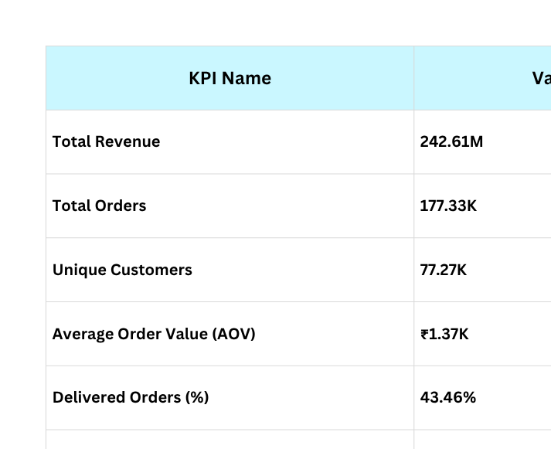
KEY METRICS AND KPIS (GLOBAL OVERVIEW)
Objective:
To summarize global retail sales performance and provide a high-level snapshot of overall revenue, customer reach, and operational flow.

Slide 16
ROOT CAUSE ANALYSIS (RCA) (GLOBAL OVERVIEW)
Objective of RCA:
To identify what factors drive total revenue variations across countries, cities, and months — and to uncover possible operational bottlenecks.
Observations & Findings:
Regional Performance
USA dominates with the highest total revenue (~₹78M), followed by UK (~₹47M) and Germany (~₹40M).
Reason: Higher transaction frequency, larger customer base, and stronger repeat purchase patterns.
City-Level Insights
Chicago (₹17.6M) and Portsmouth (₹16.7M) are the top-performing cities.
These cities likely benefit from dense customer clusters and efficient delivery infrastructure.
Monthly Sales Trend
Peaks in March and May (₹21M) indicate seasonal shopping activity — possibly linked to promotional campaigns or festival sales.
Dips in February and October (~₹19M) suggest off-season demand or marketing inactivity.
Operational Performance
Delivered Orders: 43.46% – healthy, but improvement is needed in processing and shipping efficiency (35%+ combined).
Indicates backend delays or resource imbalance during high-volume months.
Geographical Spread
Revenue map reveals concentration in North America and Western Europe,
while APAC and South America remain underrepresented — hinting at untapped potential.

Slide 17
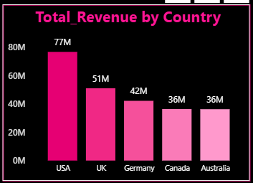
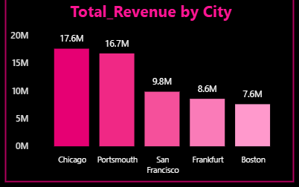
ROOT CAUSE ANALYSIS (RCA) (GLOBAL OVERVIEW)
Root Causes Identified:
Uneven regional marketing or stock availability
Seasonal purchase peaks not supported by logistics scaling
Limited presence or promotions in emerging regions
Slightly slower order completion rates affecting overall delivery %

Slide 18
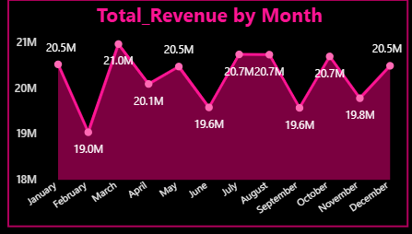
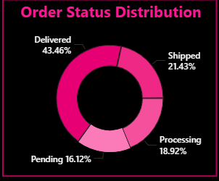
ROOT CAUSE ANALYSIS (RCA) (GLOBAL OVERVIEW)

Slide 19
RECOMMENDATIONS & INSIGHTS
Business Recommendations
Focus on Underperforming Regions (Canada & Australia)
Allocate additional marketing budgets to these regions to match U.K. and U.S. conversion levels.
Offer region-specific campaigns or limited-time offers to increase order frequency.
Optimize Order Fulfillment Efficiency
Reduce pending (16%) and processing (18%) orders by integrating real-time stock tracking and automated logistics scheduling.
Prioritize high-volume cities (Chicago, Portsmouth) for faster deliveries and stock placement.
Capitalize on Seasonal Peaks
Strengthen promotions during March–May, where sales revenue consistently peaks (~₹21M).
Use Power BI trend forecasting to anticipate next seasonal surge.
City-Level Sales Replication
Apply the Chicago model (efficient logistics + loyal customers) to Boston and Frankfurt—both show strong potential but moderate sales (~₹7–8M).
Customer Retention Initiatives
Encourage repeat orders via “Thank You” rewards or free shipping for regular customers.
Use customer segmentation insights from Dashboard 2 to identify high-value Premium and Regular segments.
Key Takeaways:
The retail network performs strongest in U.S. and U.K., while Canada and Australia offer room for growth.
Improving order fulfillment and leveraging seasonal peaks can drive overall profitability.

Slide 20
DASHBOARD-2: OVERVIEW
Purpose:
Provide a concise view of customer demographics, loyalty and spending behaviour to guide targeting and retention strategies.
Dashboard Components:
KPI Cards: Total Customers, Avg Revenue per Customer, Repeat Customers, Repeat Purchase %
Column/Bar Charts: Customer count by Age Group, Revenue share by Gender
Funnel / Bars: Customer Distribution by Income Level (funnel)
Decomposition Tree: Drivers of repeat customers (segment → income → country)
Donut / Pie: Customer Loyalty Breakdown (Repeat vs One-time)
Slicers: Year, Country, Gender, Customer Segment, Age Group
Analytical Goal:
Identify highest-value customer groups (by spend & repeat rate)
Understand demographic drivers of loyalty (age, income, segment)
Reveal operational or product gaps by cohort for targeted actions
Design Approach:
Teal/black theme, KPI-first layout, interactive filters for fast cohort comparison and drill-downs.

Slide 21
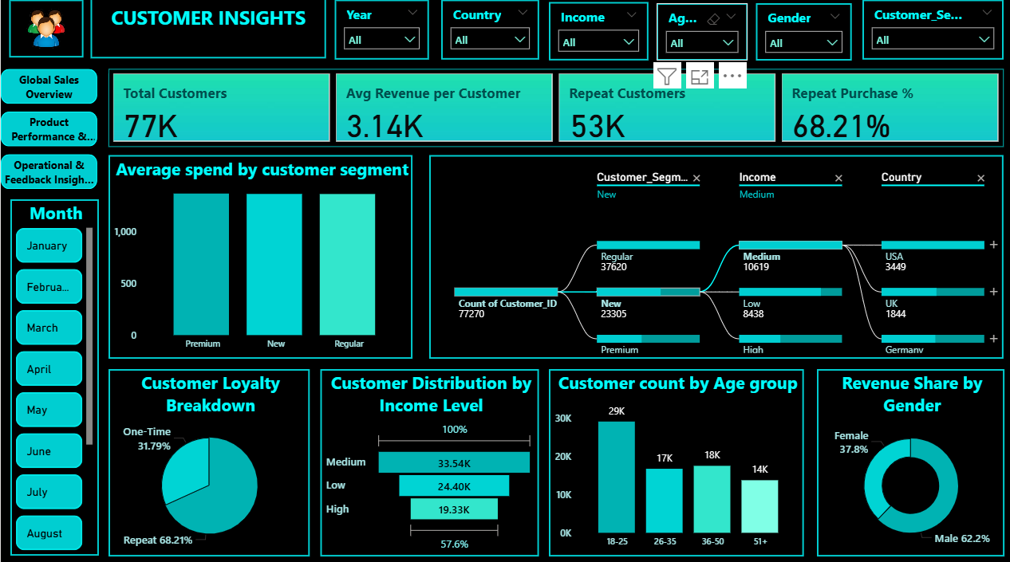
DASHBOARD-2: OVERVIEW

Slide 22
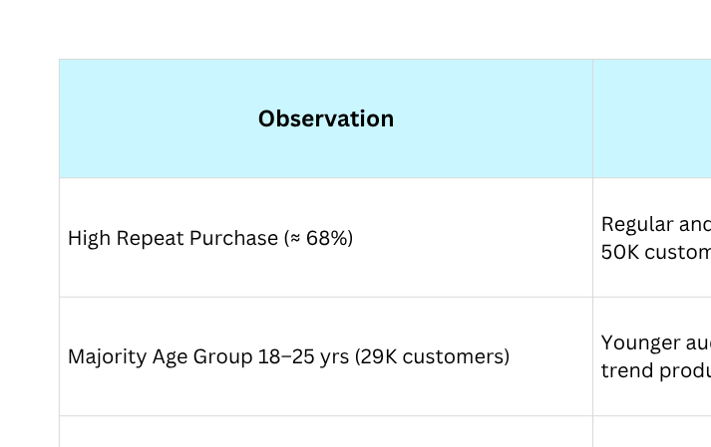
RCA (CUSTOMER INSIGHTS)
Objective:
Identify behavioral patterns and key factors influencing customer retention and spending.

Slide 23
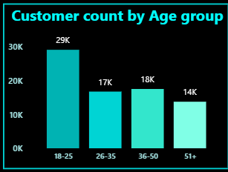
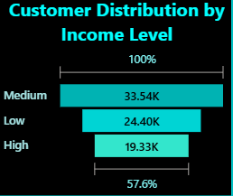
RCA (CUSTOMER INSIGHTS)

Slide 24
RECOMMENDATIONS & INSIGHTS
Objective:
Suggest actions to improve customer engagement, retention, and revenue based on insights.
Key Recommendations:
Focus on loyal customers:
Continue engagement programs for repeat buyers through loyalty rewards or exclusive discounts.
Increase average revenue:
Introduce product bundles and personalized suggestions to encourage customers to buy more in each order.
Target young audience (18–25 yrs):
Run trend-based promotions and social media campaigns since this group has the highest customer count.
Reach high-income customers:
Promote premium or limited-edition products to attract higher-value purchases.
Monitor feedback trends:
Use customer feedback data to regularly update offers and improve shopping experience.
Expected Outcomes:
Better customer retention
Higher spending per order
alanced growth across all income and age groups

Slide 25
DASHBOARD-3: OVERVIEW
Dashboard Title: Product Performance & Preferences
Purpose:
To analyze product category performance, brand strength, customer preferences, and seasonal trends to identify the most profitable and consistent product segments.
Dashboard Components:
KPI Cards: Total Products Sold, Avg Rating, Total Revenue, Total Brands
Bar Charts: Revenue by Product Category, Top 10 Brands by Revenue
Donut Chart: Revenue Share by Product Type
Scatter Plot: Product Popularity vs Customer Rating
Stacked Bar Chart: Product Category Revenue by Gender
Line Chart (with slicer): Month-wise Revenue Trend
Analytical Goal:
Enable business to understand which products, brands, and customer segments drive revenue — and how seasonality and customer demographics influence sales patterns.
Design Approach:
Clean, insight-focused layout integrating category, brand, and behavioral dimensions for comprehensive product analysis.

Slide 26
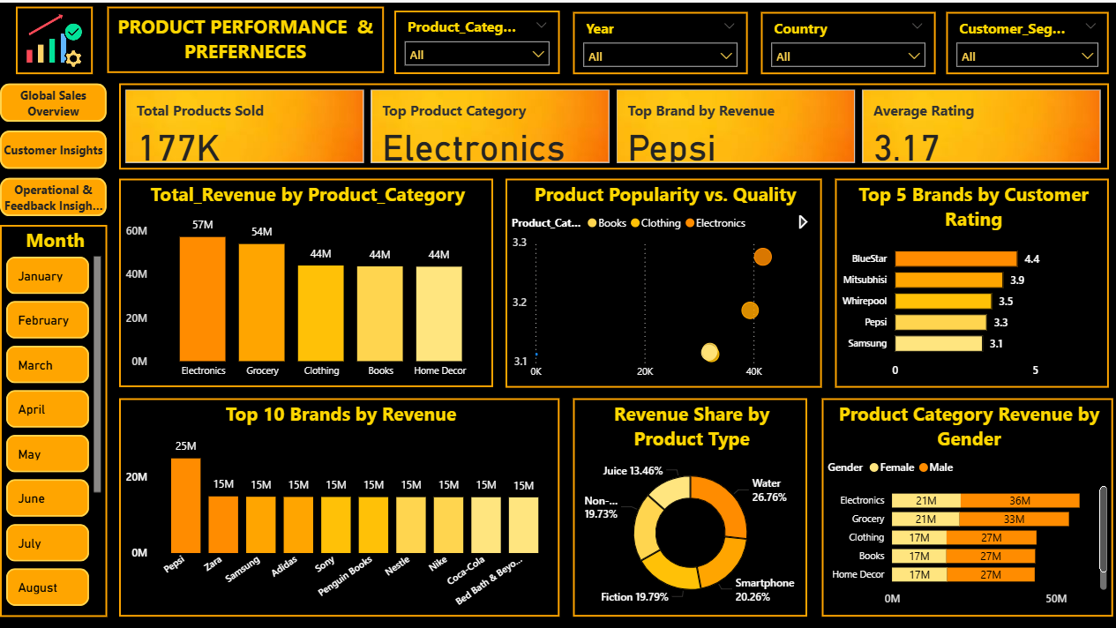
DASHBOARD-3: OVERVIEW

Slide 27
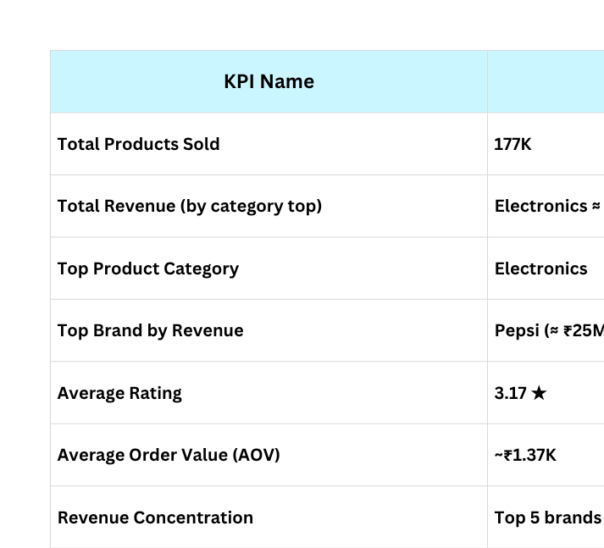
KEY KPIS (PRODUCT PERFORMANCE & PREFERENCES)
Objective:
Electronics is the dominant category (highest revenue and units). A small set of brands (Pepsi, Samsung, Zara, etc.) contributes a large share of revenue while average ratings (~3.17) show room to improve product experience and retention.

Slide 28
ROOT CAUSE ANALYSIS (DASHBOARD 3: PRODUCT PERFORMANCE & PREFERENCES)
RCA 1 – Total Revenue by Product Category
Electronics (₹57M) and Grocery (₹54M) are top categories.
Driven by essential goods & tech demand.
Indicates strong product appeal and customer trust.
RCA 2 – Top 10 Brands by Revenue
Pepsi (₹25M) leads, followed by Zara, Samsung, Adidas, Sony (~₹15M each).
Brand loyalty and wide distribution drive sales.
Revenue concentration among few top brands → diversification needed.
RCA 3 – Product Popularity vs Quality
Electronics, Clothing = High sales but only 3.2–3.3★ ratings.
Customers prioritize necessity and price over ratings.
Suggests scope to improve quality & service post-sales.
RCA 4 – Product Category Revenue by Gender
Male customers contribute ~60–65% of total revenue.
Higher engagement in Electronics, Grocery, and Books.
Indicates male-dominated spending behavior in these segments.

Slide 29
ROOT CAUSE ANALYSIS (DASHBOARD 3: PRODUCT PERFORMANCE & PREFERENCES)
RCA 5 – Revenue Share by Product Type
Water (26.8%), Smartphone (20.3%), Fiction (19.8%), and Non-Fiction (19.7%) dominate.
Reflects strong sales in essential & entertainment categories.
Suggests stable revenue diversification across daily and leisure goods.
RCA 6 – Seasonal Trends by Month (Slicer)
Electronics & Grocery consistent top performers across months.
Revenue slightly peaks in March–April and August–October, hinting festive or promotional periods.
Low seasonal fluctuation → stable year-round demand.
Overall Summary:
Product sales are stable and driven by a few strong categories and brands. Customer satisfaction is moderate, and revenue is slightly gender-skewed. Data shows opportunities in improving product quality, balancing brand reliance, and designing gender-targeted promotions.

Slide 30
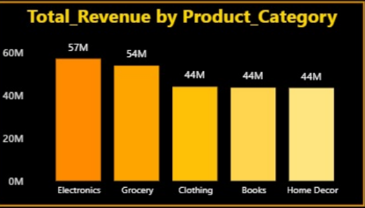
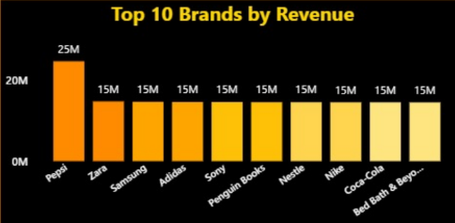
ROOT CAUSE ANALYSIS (DASHBOARD 3: PRODUCT PERFORMANCE & PREFERENCES)

Slide 31
RECOMMENDATIONS & INSIGHTS
1) Product & Inventory Optimization
Maintain higher inventory for Electronics and Grocery, as they drive maximum sales volume.
Introduce dynamic restocking for fast-selling brands (Pepsi, Samsung, Zara).
Diversify product lineup to reduce dependency on top 5 brands.
2) Quality & Customer Experience
Launch post-sale feedback and quality audit programs for high-volume but low-rated products (Electronics, Clothing).
Use customer feedback data to improve product specifications and packaging quality.
Offer extended warranty or free replacement options to strengthen trust.
3) Marketing & Targeting Strategy
Design gender-specific campaigns — male-oriented for Electronics, Books; female-focused bundles for Clothing and Home Decor.
Use Power BI segmentation filters to identify repeat buyers and upsell premium versions.
Introduce combo offers between high-performing and low-performing brands.
4) Financial & Business Planning
Focus investment on top-performing categories while gradually growing underperforming ones.
Use revenue share insights to negotiate better vendor contracts with leading brands.
Monitor monthly trends to plan seasonal campaigns (March–April & August–October).
Key Takeaway:
Balanced inventory planning, data-driven marketing, and consistent quality control will enhance profitability, customer loyalty, and overall retail growth.

Slide 32
DASHBOARD-4 OVERVIEW
(Operational & Feedback Insights)
Purpose:
To analyze post-purchase customer experience, feedback patterns, and operational performance metrics like delivery efficiency, payment mix, and order timing.
Dashboard Components:
KPI Cards: Avg Rating, Total Orders, Avg Delivery Score, Total Payment Methods
Charts:
Pie Chart → Customer Feedback Sentiment
Bar Chart → Ratings Distribution
Donut Chart → Payment Method Distribution
Bar Chart → Shipping Method Orders
Bar Chart → Peak Shopping Hours
Table → Feedback vs Delivery Status
Slicer: Month (for seasonal analysis)
Analytical Goal:
To understand how customer satisfaction and operational choices (shipping, payments, timing) interact to affect overall performance and service quality.
Design Approach:
A structured, insight-oriented layout combining operational KPIs + customer sentiment metrics for balanced decision-making.

Slide 33
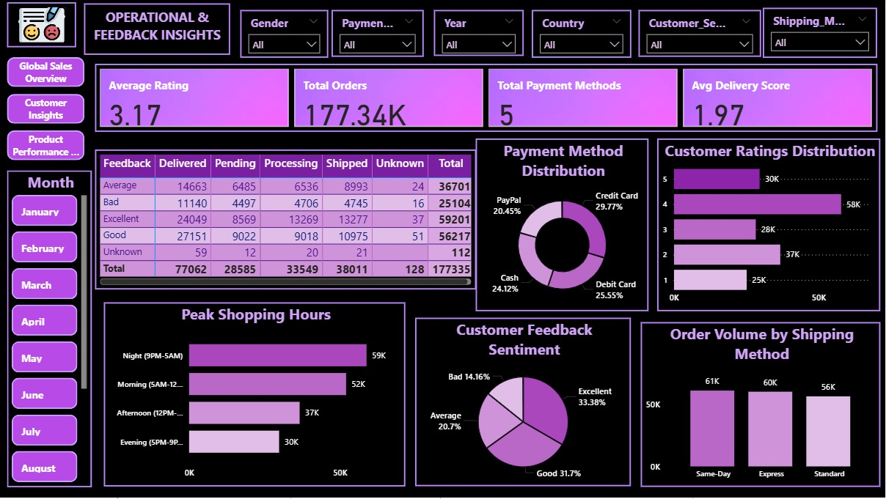
DASHBOARD-4: OVERVIEW

Slide 34
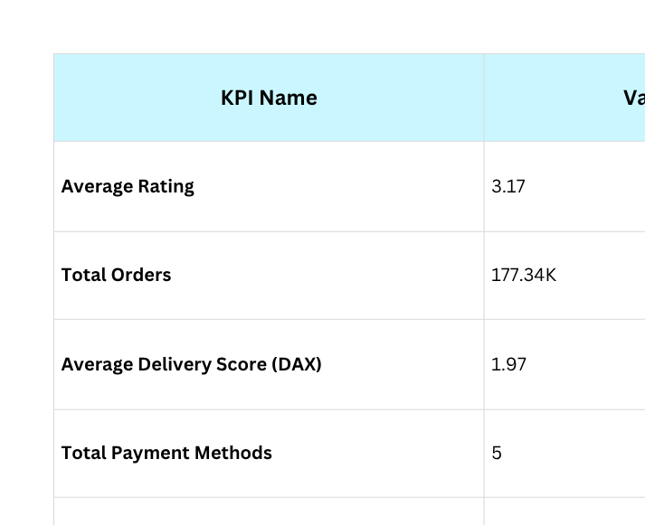
KEY KPIS (PRODUCT PERFORMANCE & PREFERENCES)
Objective:
To measure post-purchase experience, operational reliability, and customer satisfaction using feedback, delivery, and payment metrics.

Slide 35
ROOT CAUSE ANALYSIS (DASHBOARD 4: OPERATIONAL & FEEDBACK INSIGHTS)
RCA 1 – Customer Feedback Sentiment
33.38% Excellent and 31.7% Good feedback dominate.
However, 34% of responses (Average/Bad) indicate moderate service satisfaction.
Common reasons: shipping delays, packaging issues, and inconsistent communication.
RCA 2 – Customer Ratings Distribution
4★ (58K) and 5★ (30K) ratings form the majority.
Mid-tier ratings (2★–3★) suggest experience gaps post-purchase.
Reflects imbalance between customer expectations and service delivery.
RCA 3 – Payment Method Distribution
Credit Card (29.77%) is most preferred, followed by Debit Card (25.55%), Cash (24.12%), and PayPal (20.45%).
Indicates customer trust in digital modes.
Low PayPal usage may be due to limited availability or regional preference.
RCA 4 – Order Volume by Shipping Method
Same-Day (61K) and Express (60K) nearly equal; Standard slightly lower (56K).
Suggests high demand for quick fulfillment.
Reflects increasing preference for faster deliveries despite potential cost differences.

Slide 36
ROOT CAUSE ANALYSIS (DASHBOARD 4: OPERATIONAL & FEEDBACK INSIGHTS)
RCA 5 – Peak Shopping Hours
Night (9 PM–5 AM) records the highest order volume (~59K).
Morning (5 AM–12 PM) follows with ~52K orders.
Customer activity peaks during non-working hours → preference for convenience and late-night browsing.
Indicates potential for targeted night-time promotions or flash sales.
RCA 6 – Feedback vs Delivery Status (Matrix Table)
“Excellent” feedback strongly correlates with Delivered / On-Time orders (~24K+).
“Bad” feedback mostly linked to Pending / Processing / Delayed orders (~11K+).
Highlights that delivery performance directly impacts customer sentiment.
RCA 7 – Average Delivery Score (DAX Measure)
Calculated using:
AVERAGEX(df_time_cleaned, SWITCH([Shipping_Method], "Same-Day", 1, "Express", 2, "Standard", 3))
Current score ≈ 1.97, showing moderate efficiency.
Lower score implies timely deliveries but room to further improve Express and Standard timelines.

Slide 37
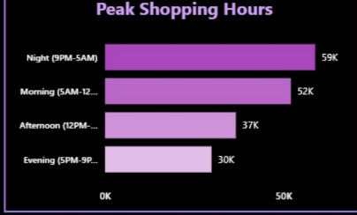
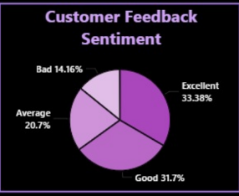
ROOT CAUSE ANALYSIS (DASHBOARD 4)

Slide 38
RECOMMENDATIONS & INSIGHTS
1. Customer Experience Enhancement
Focus on improving delivery consistency to reduce negative feedback (currently ~14%).
Implement post-delivery satisfaction surveys and quick response systems for complaints.
Introduce loyalty programs for customers giving consistent 4★–5★ ratings.
2. Logistics & Delivery Optimization
Strengthen same-day and express order handling capacities.
Use delivery tracking analytics to identify delay-prone regions or time slots.
Collaborate with multiple courier partners for balanced workload and timely shipping.
3. Feedback & Sentiment Analysis
Automate sentiment tracking from feedback text and star ratings.
Regularly compare sentiment trends with order volume and delivery performance.
Integrate Power BI alerts to notify management about rising negative sentiment.
4. Payment & Transaction Strategies
Offer cashback or reward points for preferred digital modes (Credit/Debit Cards).
Ensure secure gateways to sustain customer trust in online transactions.
Study PayPal’s lower adoption regions — enhance or replace with regional payment alternatives.
5. Peak Hour & Marketing Strategy
Leverage Night and Morning order peaks (~59K, ~52K orders) for time-based marketing campaigns.
Schedule targeted advertisements, discounts, and push notifications during these hours.

Slide 39
OVERALL BUSINESS IMPACT
Objective:
To summarize how data-driven dashboards enhanced decision-making for the retail sector.
Key Business Impacts:
Unified Insights: Consolidated data from transactions, customers, and feedback into four interactive dashboards.
Data-Driven Strategy: Helped management identify top-performing products, cities, and customer segments.
Operational Efficiency: Detected delays and optimized shipping methods, improving delivery performance.
Customer Retention: Analyzed repeat purchase behavior and improved targeting based on income and age groups.
Revenue Optimization: Supported marketing and inventory decisions through trend and category-based insights.

Slide 40
CONCLUSION & FUTURE SCOPE
Conclusion:
Successfully developed a Retail Analytics System that connects transactional, customer, and feedback data.
Enabled end-to-end insights from data cleaning to Power BI visualization.
Delivered business intelligence through interactive, filter-enabled dashboards.
Future Scope:
Predictive Analytics: Integrate Power BI Forecasting and Python ML models for demand and sales prediction.
Automation: Schedule auto-refresh for real-time data sync from databases (SQLite3 → Power BI).
Scalability: Extend system to support multi-store or e-commerce environments.
Integration: Develop mobile dashboard views for instant managerial access.

Slide 41
ACHIEVEMENTS, CHALLENGES & PERSONAL LEARNINGS
Achievements:
Designed and developed four interactive Power BI dashboards covering customer, product, sales, and feedback insights.
Successfully connected SQLite3 + Python data pipeline to Power BI for dynamic reporting.
Implemented custom DAX measures (e.g., Delivery Score, Repeat Purchase %) to enhance analytical accuracy.
Presented clean, user-friendly dashboards with consistent color themes and KPI layouts.
Challenges Faced:
Data Modeling Complexity:
→ Ensuring proper table relationships and one-to-many mappings for interactivity.
Data Inconsistencies:
→ Handling customer and product mismatches (e.g., multiple ages or genders for same ID).
⏳Performance Optimization:
→ Managing large datasets (~3 lakh records) while maintaining smooth Power BI visuals.
🔄Integration Effort:
→ Aligning SQL queries, DAX logic, and Power BI slicers for accurate insights.

Slide 42

ACHIEVEMENTS, CHALLENGES & PERSONAL LEARNINGS
Personal Learnings:
Strengthened understanding of data cleaning, SQL querying, and data visualization techniques.
Gained hands-on experience in Power BI storytelling and dashboard design principles.
Improved analytical thinking, problem-solving, and ability to communicate insights effectively.

Slide 43
PROJECT LIMITATIONS
Dataset coverage: Limited to countries present in the Kaggle source (US, UK, Germany, Canada, Australia); no APAC / South America representation.
Temporal constraints: Data covers historic transactions only — no real-time streaming or live POS feeds.
Data quality issues: Customer/product attribute conflicts (multiple ages/genders per ID) required rule-based resolution.
Modeling trade-offs: Star schema built on cleaned snapshots — late-arriving data and slowly changing attributes not fully modeled.
Resource & performance limits: Working with ~300K rows in Power BI required visual and refresh optimizations; very large enterprise data may need a data warehouse.
Operational validation: Some operational metrics (delivery scoring) are proxy/DAX-based estimates and may need ground-truth verification from courier/logistics systems.

Slide 44
THANK YOU

